Slide 1


Introduction to Node.js
Node.js
Front-end, back-end, and where Node.js fits in
National Telecommunication Institute

Slide 2
What is Node.js?
Front-end (browser)
Back-end (server)
Runs in the user’s browser
Runs on a server
?
?
National Telecommunication Institute · Introduction to Node.js
03

Slide 3

What is Node.js?
Front-end (browser)
Back-end (server)
Runs in the user’s browser
Runs on a server
National Telecommunication Institute · Introduction to Node.js
04

Slide 4
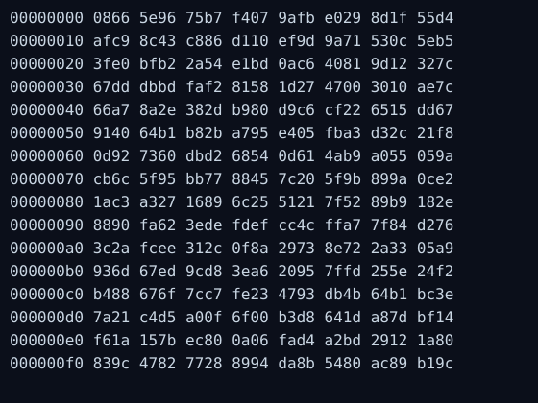

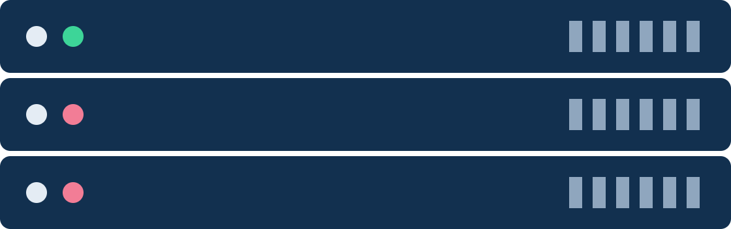
Computers & Code
Assembly Language
Machine code
Machine code
Assembly language
National Telecommunication Institute · Introduction to Node.js
05

Slide 5
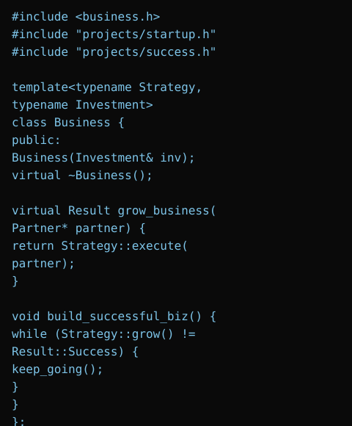
Computers & Code
C++
Assembly Language
Machine code
C++
National Telecommunication Institute · Introduction to Node.js
06

Slide 6
JavaScript in Browsers
National Telecommunication Institute · Introduction to Node.js
07

Slide 7

JavaScript in Browsers
V8 engine compiles JavaScript into machine code
C++
National Telecommunication Institute · Introduction to Node.js
08

Slide 8
Enter Node.js
Node.js
Node.js is written in C++
National Telecommunication Institute · Introduction to Node.js
09

Slide 9

Enter Node.js
Node.js
Machine
Code
Node.js is written in C++
National Telecommunication Institute · Introduction to Node.js
10

Slide 10



Node is more than V8…
Read & write files on a computer
Node.js
Adds more features to JavaScript
Connect to a database
Act as a server for content
National Telecommunication Institute · Introduction to Node.js
11

Slide 11
Computers & Code
Node.js
JavaScript
C++
Assembly Language
Machine code
National Telecommunication Institute · Introduction to Node.js
12

Slide 12




What’s an API?
An API allows different applications to talk to each other using requests and responses.
Request
Application A
Application B
API
Response
National Telecommunication Institute · Introduction to Node.js
24

Slide 13


API Types
REST API
GraphQL
Uses standard HTTP requests and URLs to work with data
Lets the client ask for exactly the data it needs
National Telecommunication Institute · Introduction to Node.js
25

Slide 14
What’s JSON?
{
JSON = JavaScript Object Notation
"id": 1,
"course": "Node.js",
"level": "beginner",
A lightweight format for storing and sharing data between systems
"online": true
}
National Telecommunication Institute · Introduction to Node.js
26

Slide 15


Why JSON?
Easy to read
Lightweight
Works everywhere
Clear, human-friendly structure
Small and fast to send between systems
JavaScript, Python, PHP…
National Telecommunication Institute · Introduction to Node.js
27

Slide 16

The Role of Node.js
National Telecommunication Institute · Introduction to Node.js
13

Slide 17




The Role of Node.js
Node.js
Request
Response
Browser
National Telecommunication Institute · Introduction to Node.js
14

Slide 18
But why use Node.js?
1
No need to learn an extra language for server
2
Can share code between front and back end
3
Node.js has a massive community behind it
4
Huge amount of third-party packages & tools to help
National Telecommunication Institute · Introduction to Node.js
15

Slide 19
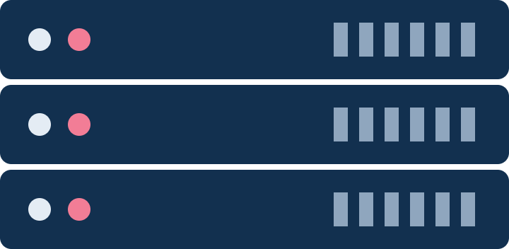
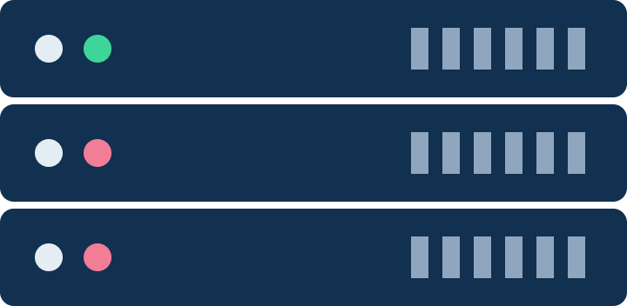
IP Addresses
Host
172.16.254.1
192.168.1.1
216.58.216.164
National Telecommunication Institute · Introduction to Node.js
16

Slide 20
IP Addresses
Host
NTI.com
Look-up IP address associated with that domain
216.58.216.164
National Telecommunication Institute · Introduction to Node.js
17

Slide 21
IP Addresses
GET Request
Look-up IP address associated with that domain
Host
NTI.COM
216.58.216.164
National Telecommunication Institute · Introduction to Node.js
18

Slide 22
IP Addresses
GET Request
Look-up IP address associated with that domain
Host
NTI.com
216.58.216.164
Communication via HTTP
Hyper-Text Transfer Protocol
National Telecommunication Institute · Introduction to Node.js
19

Slide 23


Localhost
Localhost is like a domain name on the web
127.0.0.1
localhost
Own computer
National Telecommunication Institute · Introduction to Node.js
20

Slide 24




Port Numbers
Port numbers are like ‘doors’ into a computer
Our server
Port 3000
National Telecommunication Institute · Introduction to Node.js
21

Slide 25
Status Codes
Status codes describe the type of response sent to the browser
200
301
404
500
OK
Resource moved
Not found
Internal server error
National Telecommunication Institute · Introduction to Node.js
22

Slide 26
Status Codes
100 Range
informational responses
200 Range
success codes
300 Range
codes for redirects
400 Range
user or client error codes
500 Range
server error codes
National Telecommunication Institute · Introduction to Node.js
23

Slide 27
Assignment: Multi-Page Server
Create a server with the http module (port 3000) that returns the right HTML page for each route.
/home
views/index.html
/about
views/about.html
/contact
views/contact.html
Other
404 page with status code 404
Submit
Project zip + a screenshot of each page
National Telecommunication Institute · Introduction to Node.js
28

